Slide 1
Rotational Molding(1)
An Introduction to the Basics

Slide 2

Example Product

Slide 3
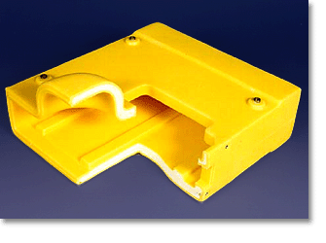
Example Product

Slide 4
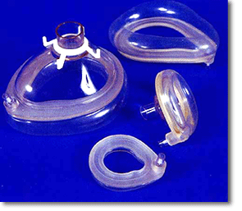
Example Product

Slide 5

Example Product

Slide 6
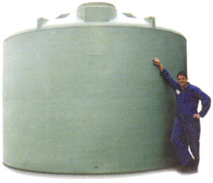
Example Product

Slide 7

Example Product

Slide 8
Presentation Outline
Introduction
The Materials
The Machines
The Molds
The Method
Conclusion

Slide 9
Introduction
Also known as rotomolding or rotocasting
Process for manufacturing large, hollow, one-piece plastic products
Best know for the manufacture of tanks and toys (Little-Tykes)
Suitable for small & complex shapes

Slide 10
Introduction
Historical Development
  1850’s: Patent granted for rotomolding principle
  1910’s: Method used for chocolate products
  1940’s: Method used for vinyl plastisols
  1950’s: Invention of PE for the process
  1960’s: Rapid expansion in toy industry
  1970’s: Gradual expansion for technical products
  1990’s: Significant improvement in process control (at QUB)

Slide 11

Introduction
1500 Rotomolders around the world

Slide 12
Introduction
North American Market Segments

Slide 13
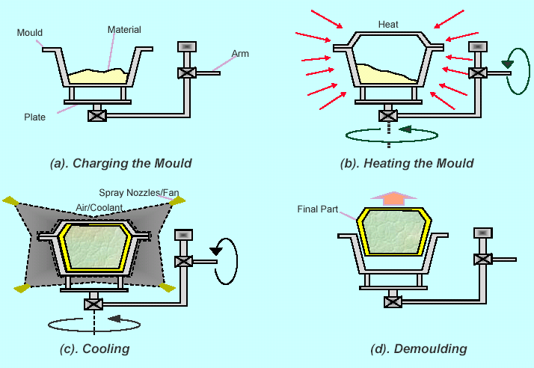
Introduction – The Process

Slide 14
Introduction
Strengths
  Small production runs
  Large part capability
  Low tooling costs
  ‘Stress-free” products
  Short product development lead times

Slide 15
Introduction
Weaknesses
  Slow cycle times
  Limited material choices
  Difficult to automate
  Poor image
  Low technology culture

Slide 16
Presentation Outline
Introduction
The Materials
The Machines
The Molds
The Method
Conclusion

Slide 17
The Materials

Slide 18
The Materials
Low Zero Shear Viscosity is required to aid in the flow of the polymer within mold
MFI
  Lower MFI resins – high strength products
  Higher MFI – good surface finish and surface detail

Slide 19
The Materials
Particle shape and size is crucial to the flow characteristics as the mold is rotating
  Standard size is a 35 mesh powder (500 micron, 0.0197 inches)

Slide 20
The Materials
Dry-flow/Bulk-density characteristics
  Dry-flow is the time it takes 100 grams of resin powder to pass through a funnel of given dimensions
  Bulk-density is the quantity of undisturbed powder than can fit inside a beaker of specified dimensions
  Inversely proportional to each other

Slide 21
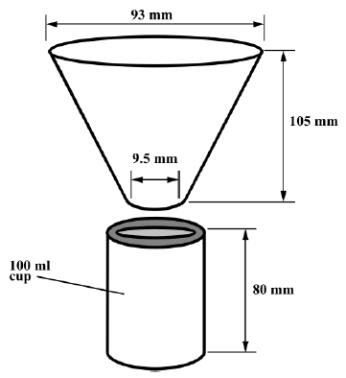
The Materials

Slide 22
The Materials
Other Material
  Foams
    Post-process
    In-process
  Liquid reactive polymers
  Micro-pellets
  Additives
  Ceramics

Slide 23
Presentation Outline
Introduction
The Materials
The Machines
The Molds
The Method
Conclusion

Slide 24
The Machines
Rock-and-Roll
Clamshell
Vertical
Shuttle
Carousel
  Fixed
  Independent
Electric & Jacket

Slide 25
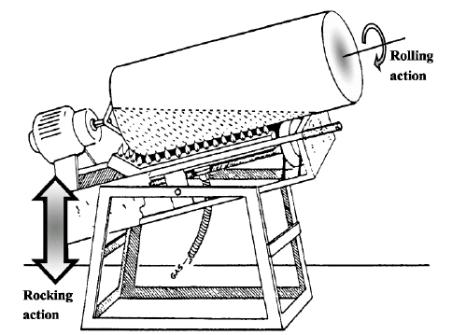
Rock-and-Roll Machines

Slide 26
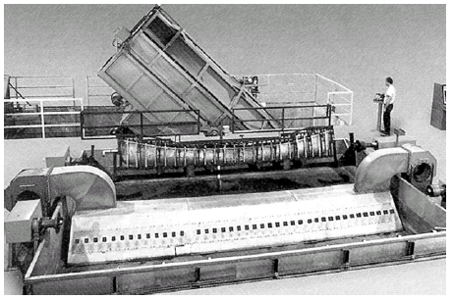
Rock-and-Roll Machines

Slide 27
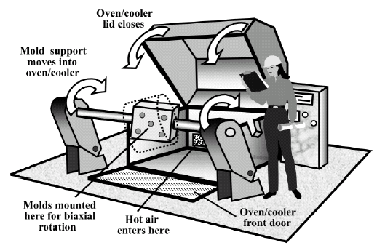
Clamshell Machines

Slide 28
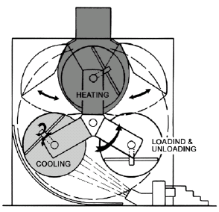
Vertical Machines

Slide 29
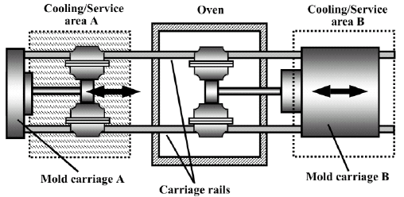
Shuttle Machines

Slide 30
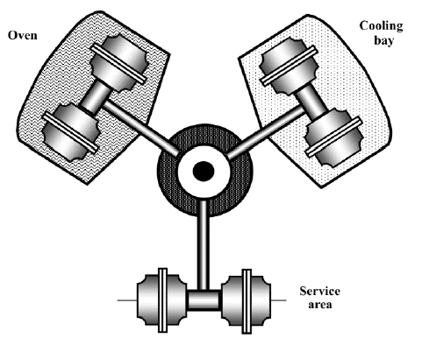
Fixed Carousel Machines

Slide 31
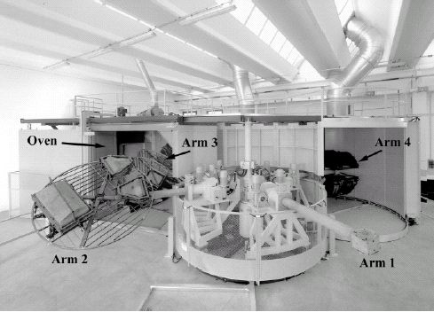
Independent Carousel Machines

Slide 32
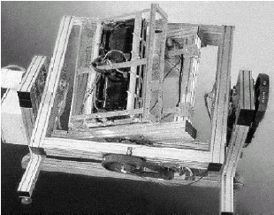
Electric Machines

Slide 33
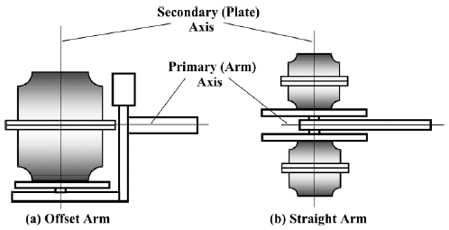
The Machines
The “ARM” and “PLATE”

Slide 34
Presentation Outline
Introduction
The Materials
The Machines
The Molds
The Method
Conclusion

Slide 35
The Molds
Materials
  Steel
    Mild
    Stainless
  Aluminum
    Cast
    Machined
    Plate

Slide 36
The Molds
Anatomy
  Frame and Spider
  Two or more sections (with draft)
  Parting line with alignment features
  Clamping hardware and pry-points
  Vent (breather) tubes
  Texture and other features
  Release agents

Slide 37
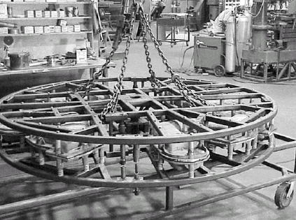
The Molds – Frame and Spider

Slide 38
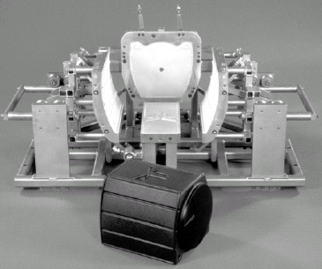
The Molds - Mold Sections

Slide 39
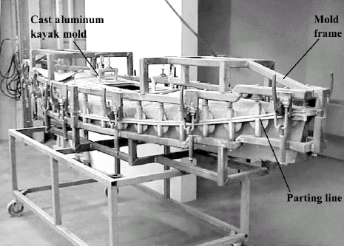
The Molds - Parting Line

Slide 40
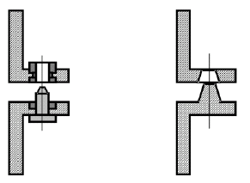
The Molds - Parting Lines

Slide 41
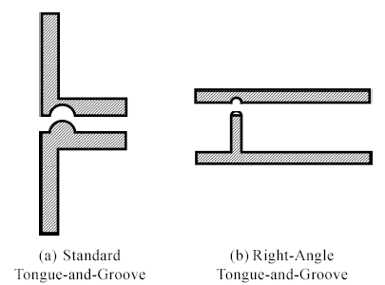
The Molds - Parting Lines

Slide 42
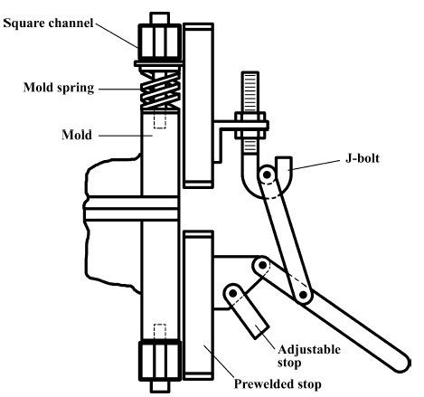
The Molds - Clamping Hardware

Slide 43
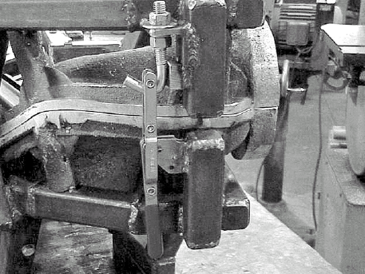
The Molds – Pry Points

Slide 44
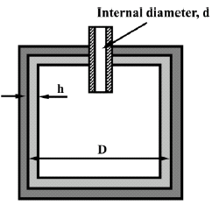
The Molds - Vents

Slide 45
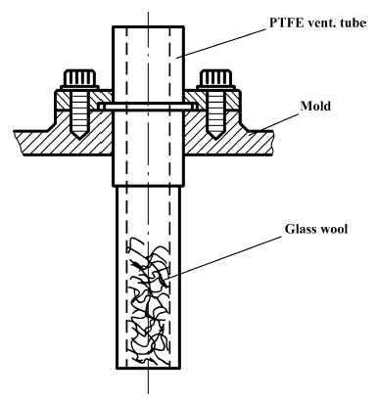
The Molds - Vents

Slide 46
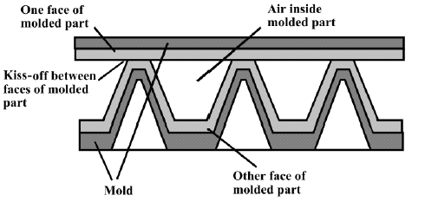
The Molds – Kiss-Offs

Slide 47
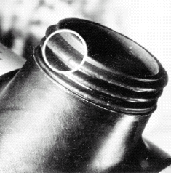
The Molds - Threads

Slide 48
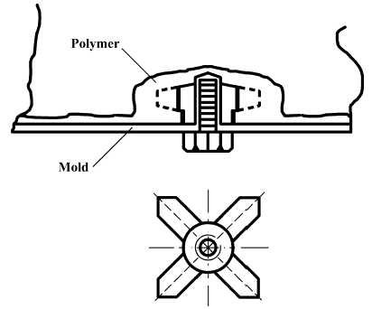
The Molds - Inserts

Slide 49
Presentation Outline
Introduction
The Materials
The Machines
The Molds
The Method
Conclusion

Slide 50
The Method
Loading
Heating
Cooling
Unloading

Slide 52
The Method - Loading
A predetermined amount of resin is loaded into the mold
The mold is closed after the flanges have been cleared of resin particles
The mold is secured shut
Rotate the mold to ensure no tools have been left on the machine

Slide 53
The Method - Heating
Rotate the mold in a high-temperature environment
The resin will always sit at the lowest point of the cavity (powder pool)
It will slowly coat the mold interior until all the resin has melted
The resin will then continue to densify as the gap between the particles disappears
Remove the mold from the oven when the powder has completely melted and densified

Slide 54
The Method - Cooling
Rotate the mold in a room temperature environment
This allows the layer of resin to cool and solidify
Water can also be used, but care should be exercised

Slide 55
The Method - Unloading
Remove the clamping system
“Pry” open the mold
Lift the completed, hollow, one-piece part from the mold.
Repeat the cycle

Slide 56
The Method
The concern
  How do you really know when it is time to do the next step?
    When is the resin melted?
    When is it cooled?
  In the early 90’s, QUB invented an instrument that revolutionized process comprehension and control
    The Rotolog™

Slide 57
The Method – Rotolog™
Temperature sensors (4 type-K Thermocouples)
RF Transmitter
RF Receiver and Signal Conditioner
Computer Software
  Real time monitoring of the temperatures

Slide 58
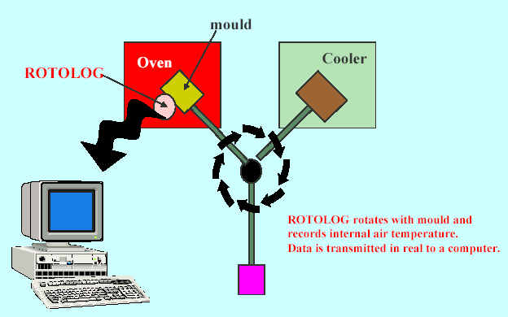
The Method – Rotolog™

Slide 59
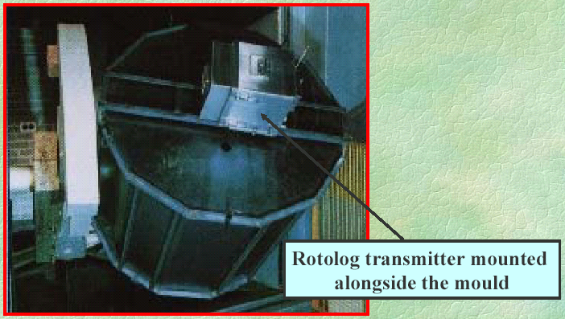
The Method – Rotolog™

Slide 60
The Method – Temperature Profiles

Slide 61
The Method – IAT Profile

Slide 62
The Method – IAT Profile

Slide 63
The Method – IAT Profile

Slide 64
The Method – IAT Profile

Slide 65
The Method – IAT Profile

Slide 66
The Method – IAT Profile

Slide 67
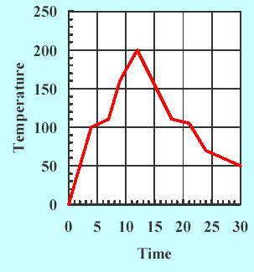
The Method – IAT Profile
We can thus observe:
When powder first sticks to the mold
When the powder has been consumed
When optimal melt sintering has occurred
When solidification is occurring
When the plastic separates from the mold
C
B
D
A
E

Slide 68
The Method – IAT Profile
The Peak Internal Air Temperature (PIAT) is the key process control parameter and is independent of all other process variables (point C)
C

Slide 69
The Method
Other important (QUB) developments
  Pressurization (Dynamic Venting)
  Permanent temperature feedback (K-Kontrol)
  RotoSim computer simulation
  Worldwide training seminars and consulting
  PPRC – Rotomolding division

Slide 70
Presentation Outline
Introduction
The Materials
The Machines
The Molds
The Method
Conclusion

Slide 71
Conclusion
Though in a state of infancy, Rotomolding offers unique advantages over other plastics processes
There are endless opportunities for research and development
Rotomolding has a very promising future, more so than many competing processes

